Slide 1

Bike Sharing Demand Analysis Project Using Excel
NextHikes Project |
Conducted by Varun

Slide 2
Project Overview & Objectives
Our Mission
Key Goals
This comprehensive analysis examines bike sharing demand by strategically merging three distinct datasets to uncover meaningful usage patterns and behavioral trends. We leverage Excel's powerful data manipulation and visualization capabilities to transform raw data into actionable business intelligence.
Perform data cleaning, merging, and transformation using Excel Power Query
Build dynamic pivot tables to analyze multidimensional patterns
Create compelling visualizations to communicate findings
Identify demand drivers and user segments for strategic decision-making

Slide 3




Data Sources & Initial Preparation
Dataset 1 & 2
Dataset 3
Data Cleaning
Monthly trip records containing comprehensive ride details including start/end timestamps, station locations, ride duration, and trip identifiers
User demographics and bike type information including membership status, user attributes, and equipment specifications
Systematic validation for missing values, duplicate records, and format consistency across all datasets to ensure analysis accuracy

Slide 4
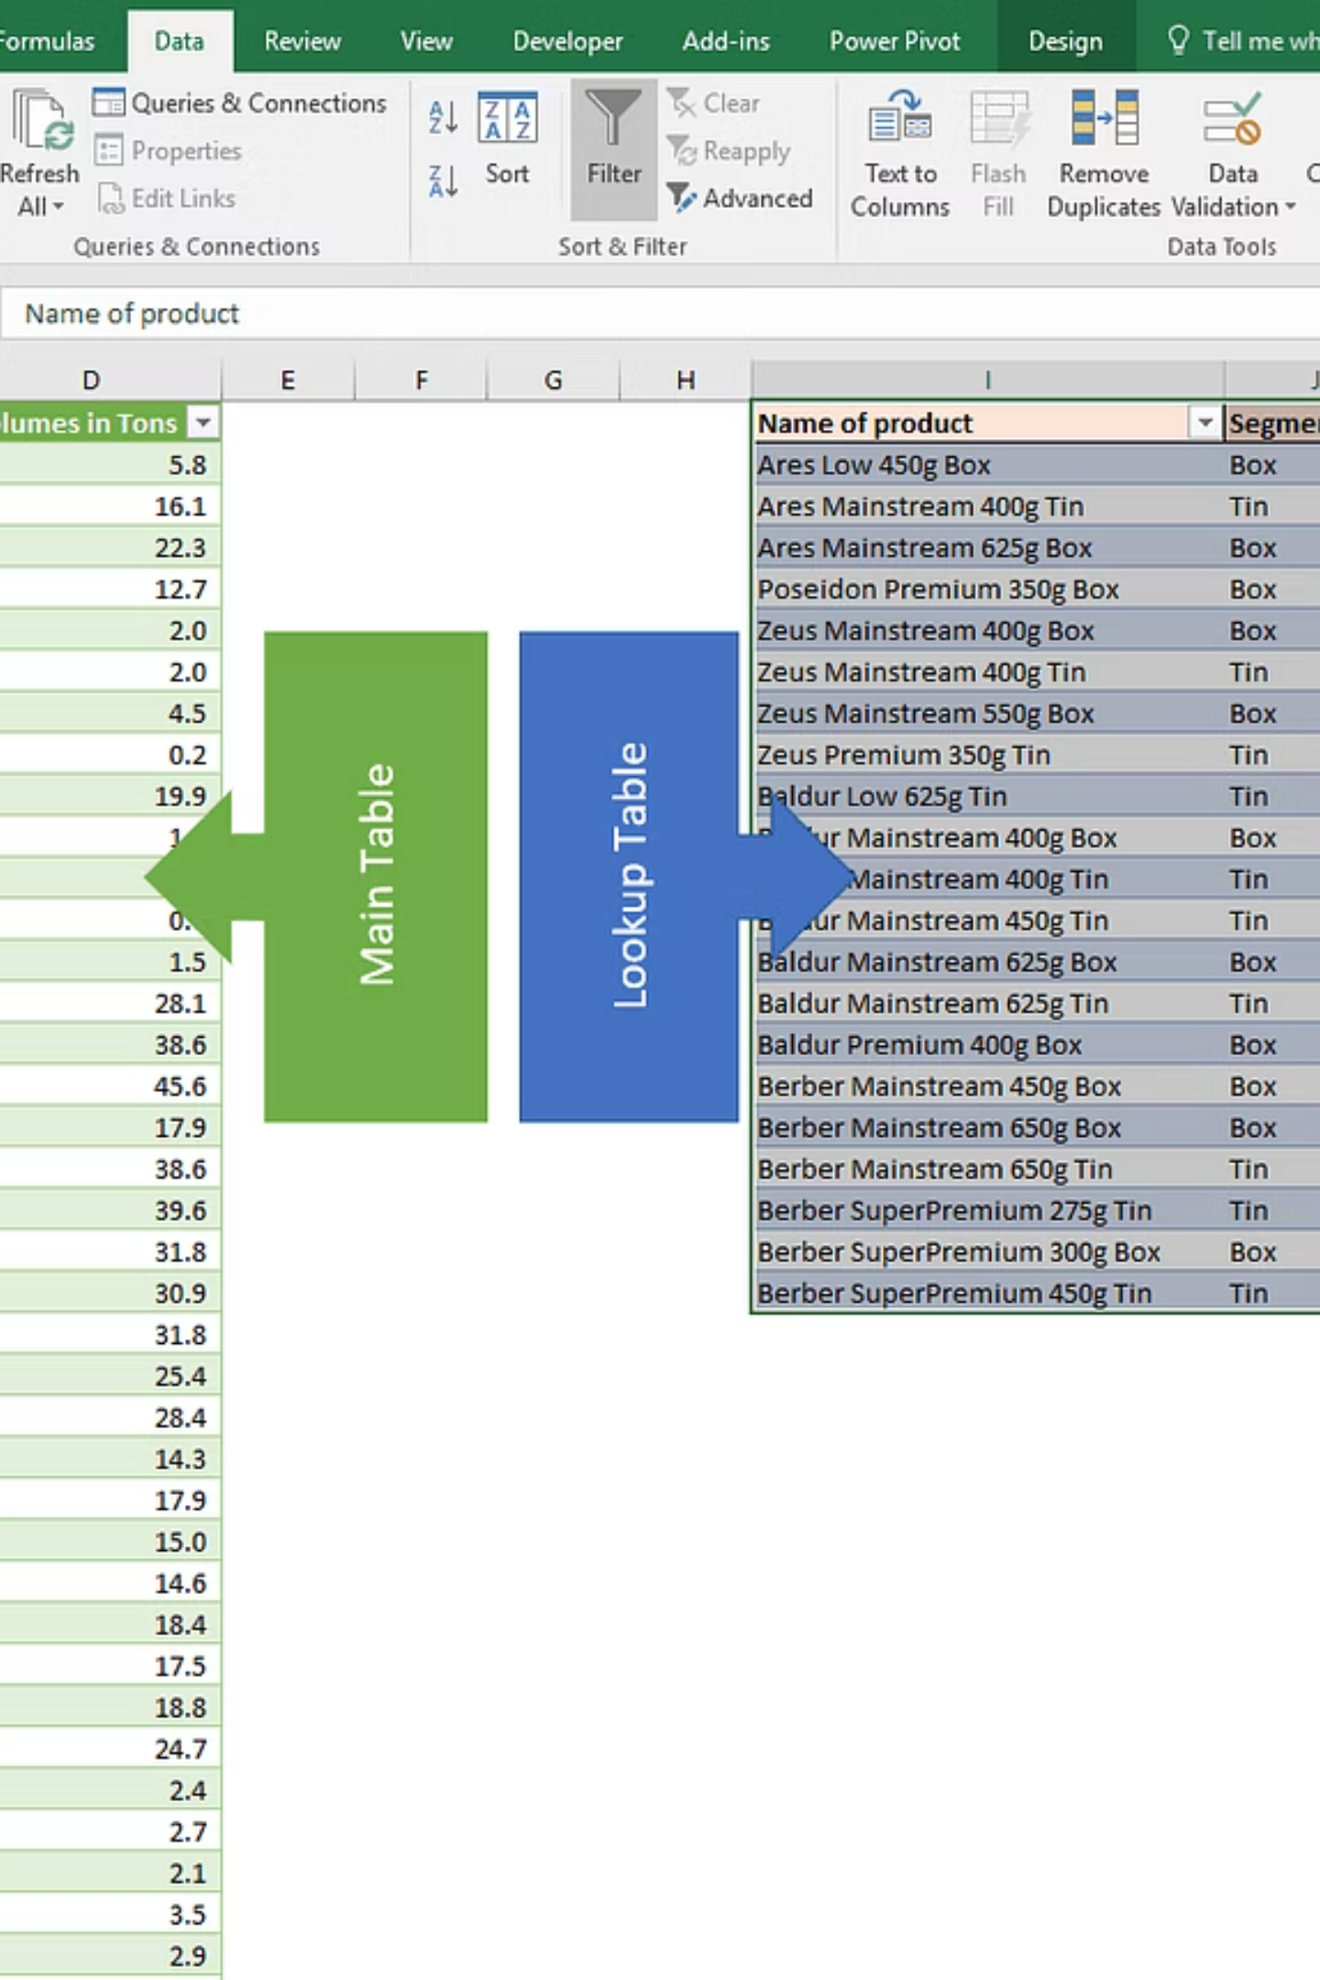

Merging Strategy: Step 1
01
02
Identify Common Keys
Power Query Integration
Establish ride_id and date as primary matching fields between Dataset 1 and Dataset 2
Utilize Excel Power Query to efficiently append and consolidate monthly trip records
03
Validate Results
Verify data integrity and unified structure for seamless downstream analysis
Result: Combined trips dataset with standardized schema and complete temporal coverage ready for enrichment

Slide 5
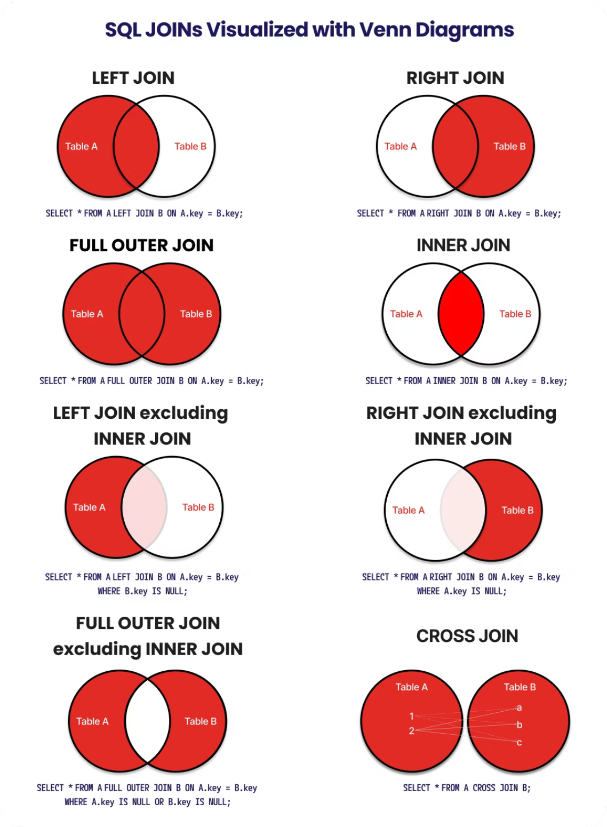
Merging Strategy: Step 2
Enriching Trip Data
The second merge operation joins our consolidated trips data with Dataset 3, enriching each ride record with valuable user demographics and bike type specifications.
Join Strategy: Left join on user_id or bike_id ensures all trip records are preserved while appending relevant user and equipment attributes.
Data Enhancement: Each trip now includes membership type, user segment classification, bike model, and equipment features.
Final Output: A comprehensive unified dataset ready for multidimensional demand analysis

Slide 6
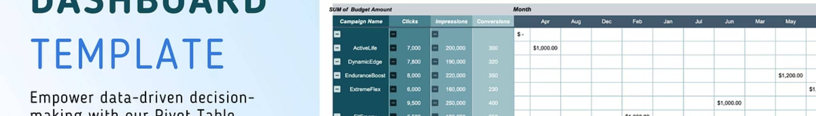
Data Analysis with Pivot Tables
1
2
User Segmentation
Temporal Patterns
Total rides analyzed by user type, distinguishing casual riders from annual members to understand engagement patterns
Ride counts aggregated by day of week and hour of day to identify peak usage windows and demand cycles
3
4
Geographic Hotspots
Dynamic Filtering
Popular start and end stations mapped to reveal high-traffic locations and critical infrastructure nodes
Pivot table slicers applied to isolate peak demand periods, seasonal variations, and specific user segments

Slide 7
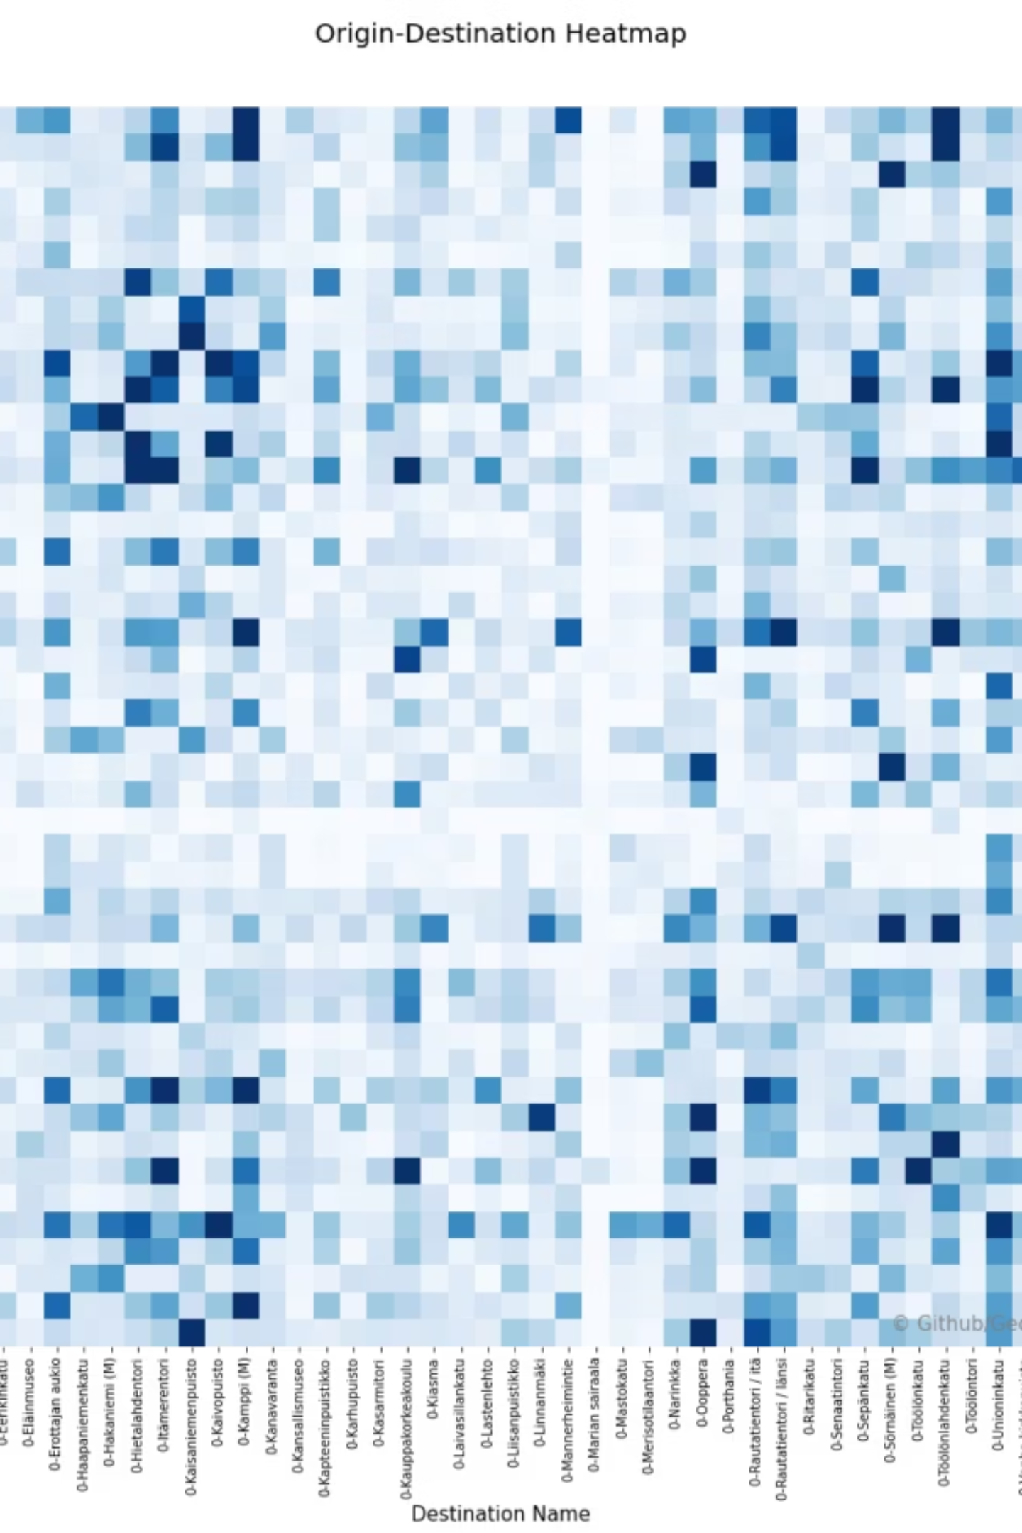



Key Insights from Pivot Tables
Weekday vs. Weekend Patterns
Annual members demonstrate significantly higher ridership during weekdays, aligning with commuter behavior. Casual riders peak dramatically on weekends, indicating recreational usage patterns.
Rush Hour Dominance
Morning (7-9 AM) and evening (5-7 PM) rush hours show the highest demand concentration for members, confirming commute-driven usage.
Station Demand Hotspots
Analysis reveals certain stations consistently show exceptional usage volumes, indicating strategic demand centers near transit hubs and business districts.

Slide 8
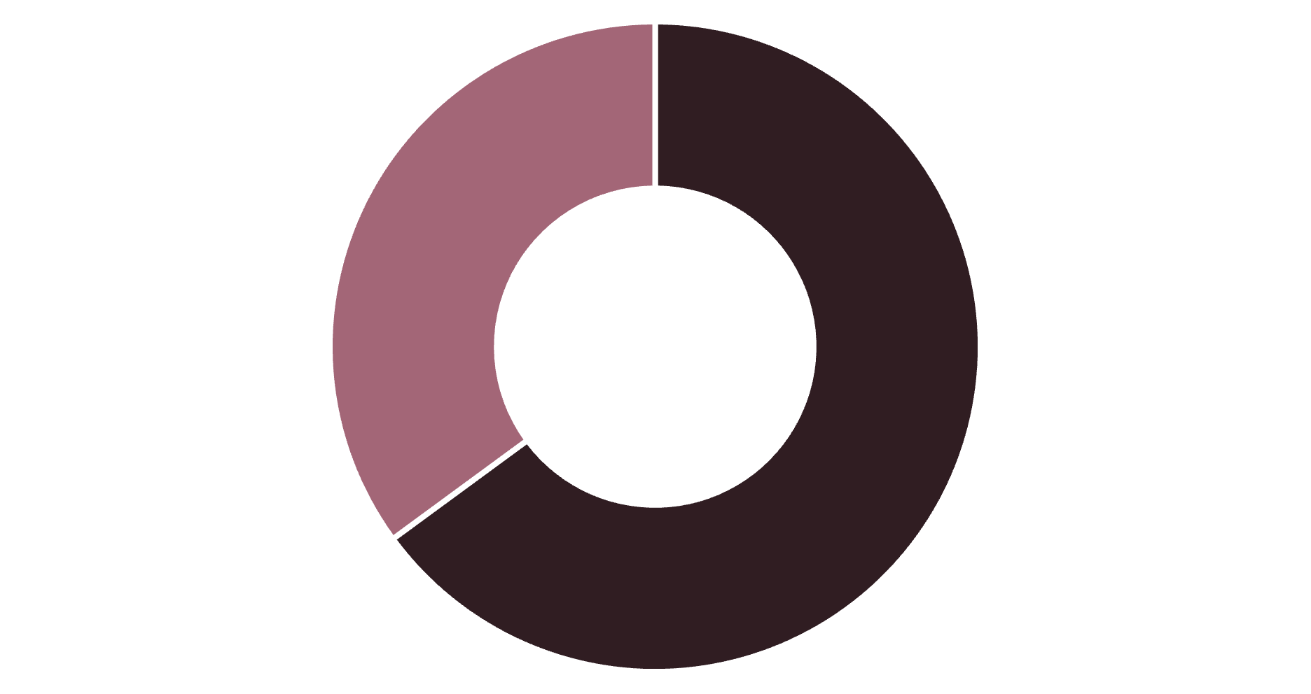
Visualizing Demand: User Type Distribution
Strategic Implications
The pie chart reveals that annual members comprise 65% of total rides, while casual riders account for 35% of usage—a substantial segment representing significant growth opportunity.
Key Takeaway: The sizeable casual rider base presents a prime target for membership conversion campaigns, with potential to drive 50%+ revenue growth through strategic marketing.
Annual Members
Casual Riders

Slide 9


Additional Visualizations & Findings
40%
2.3x
15
Summer Demand Surge
Electric Bike Preference
Top Station Concentration
Seasonal analysis shows summer months experience 40% higher ridership compared to winter baseline
Electric bikes show 2.3x higher selection rate among casual riders versus standard bikes
Just 15 stations account for 45% of all system rides, indicating highly concentrated demand
Bar charts analyzing rides by bike type reveal strong preferences for electric bikes, particularly among casual riders seeking convenience. Geographic visualizations highlight opportunity zones for expansion and rebalancing strategies.
Data-Driven Recommendations: Insights enable targeted marketing campaigns, dynamic pricing strategies, and optimized fleet allocation across peak demand periods and high-traffic locations.

Slide 10

Conclusion & Next Steps
Project Achievements
Strategic Recommendations
Successfully merged three datasets using Excel Power Query to create unified analytical foundation
Launch targeted conversion campaigns to transform casual riders into annual members
Deployed pivot tables to uncover multidimensional patterns in user behavior and temporal demand
Optimize bike availability and rebalancing during identified peak demand windows
Generated compelling visualizations communicating actionable insights to stakeholders
Expand electric bike fleet to capitalize on demonstrated preference trends
Thank you for your attention

